Slide 1

Computing Algorithms Lecture 13: Dynamic Programming / Greedy Algorithm
By: Dr. Mohamed Moheeb

Slide 2
Agenda
Introduction to dynamic programming
Basic problems
Knapsack problem
Warshall’s and Floyd’s Algorithms
Introduction to Greedy algorithm
Prim’s Algorithm
Kruskal’s Algorithm
Dijkstra’s Algorithm
Huffman Trees and Condes

Slide 3

Introduction

Slide 4
Introduction of Dynamic programming
Solve Once, Reuse Often: Break complex problems into simpler, overlapping subproblems and ensure each is solved only once to eliminate computational redundancy.
Trade Space for Time: Use Memorization (storing results in a table) to transform slow, exponential-time algorithms into fast, linear or polynomial-time solutions.
Optimal Substructure: Identify patterns where a global optimal solution can be built directly from the optimal solutions of its smaller sub-parts.

Slide 5
Basic Problems

Slide 6

Coin- Row problem
Coin-row problem There is a row of n coins whose values are some positive integers c1,c2,...,cn, not necessarily distinct.
The goal is to pick up the maximum amount of money subject to the constraint that no two coins adjacent in the initial row can be picked up.

Slide 7
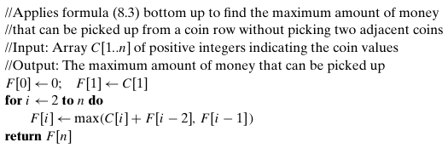
Coin Row

Slide 8
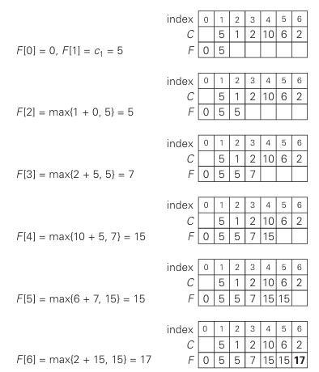
Coin Row
Solving the coin-row problem by dynamic programming for the coin row 5, 1, 2, 10, 6, 2.

Slide 9
Knapsack Problem

Slide 10
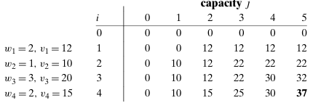
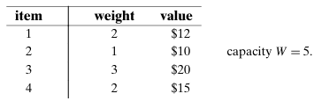
Knapsack Problem

Slide 11
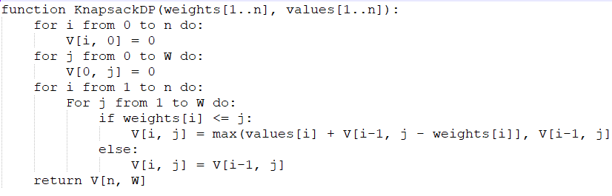

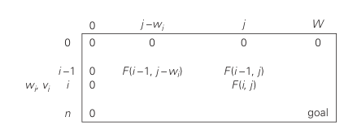
Knapsack Problem

Slide 12
Warshall’s and Floyd’s Algorithms

Slide 13
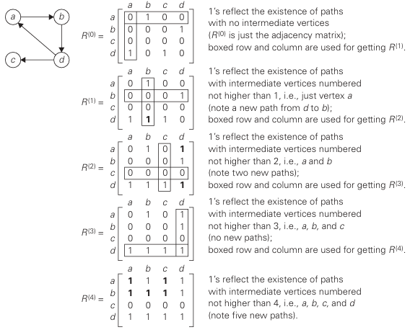
Warshall’s Algorithm

Slide 14
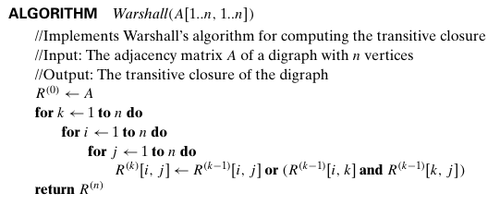
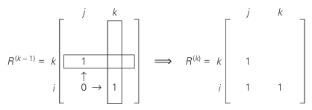
Warshall’s Algorithm

Slide 15
Warshall’s Algorithm

Slide 16
Warshall’s Algorithm

Slide 17
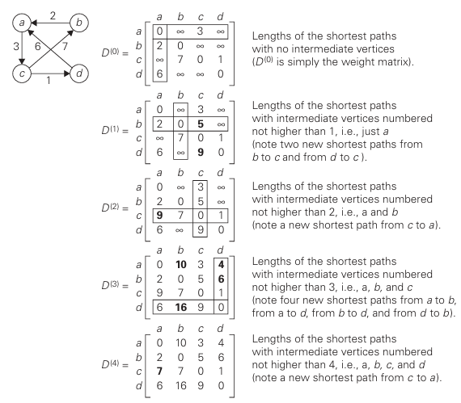
Floyd’s Algorithm

Slide 18
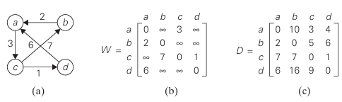
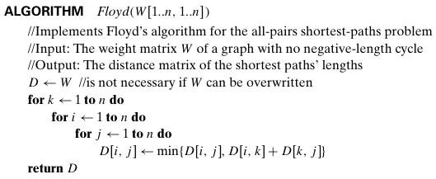
Floyd’s Algorithm

Slide 19
Introduction

Slide 20
Introduction to Geedy Algorithm
A greedy algorithm builds a solution piece by piece, choosing the next piece based on a specific greedy heuristic. At any given stage, the algorithm manages three sets:
Candidate Set: The collection of choices from which a solution is created.
Selection Function: Identifies the best candidate to be added to the solution.
Feasibility Function: Determines if a candidate can be used to contribute to the final solution without violating constraints.

Slide 21
Introduction to Geedy Algorithm
For a greedy algorithm to yield a mathematically exact and globally optimal solution, the problem must possess two key properties:
Greedy Choice Property: A global optimum can be arrived at by selecting a local optimum. In other words, choices made in the past do not affect the choices needed in the future.
Optimal Substructure: An optimal solution to the problem contains within it optimal solutions to its subproblems.
Example: Coin change problem

Slide 22
Prim’s Algorithm

Slide 23
Minimum Spanning Tree
A spanning tree of an undirected connected graph is its connected a cyclic subgraph (i.e., a tree) that contains all the vertices of the graph.
If such a graph has weights assigned to its edges, a minimum spanning tree is its spanning tree of the smallest weight, where the weight of a tree is defined as the sum of the weights on all its edges.
The minimum spanning tree problem is the problem of finding a minimum spanning tree for a given weighted connected graph.

Slide 24
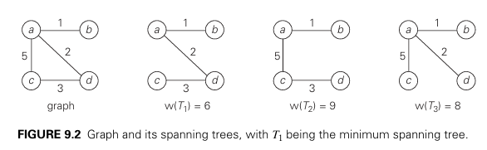
Minimum Spanning Tree

Slide 25
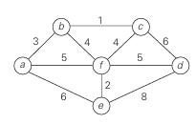
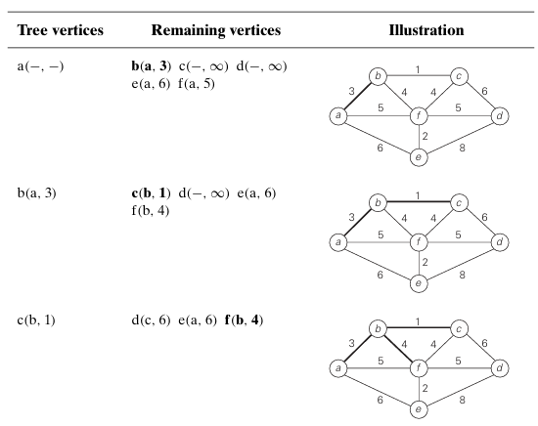
Prim’s Algorithm

Slide 26
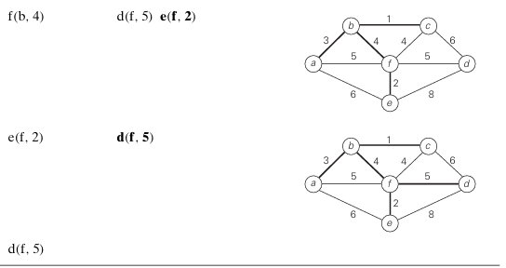
Prim’s Algorithm

Slide 27
Kruskal’s Algorithm

Slide 28
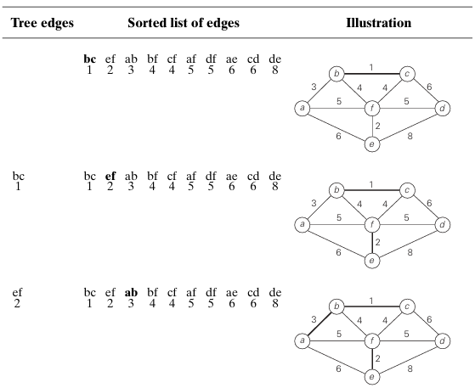
Kruskal’s Algorithm

Slide 29
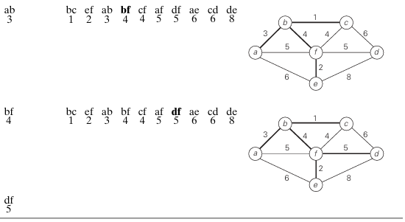
Kruskal’s Algorithm

Slide 30
Dijkstra’s Algorithm

Slide 31

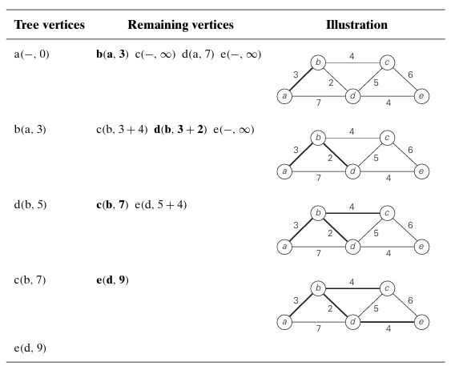
Dijkstra’s Algorithm

Slide 32
Huffman Trees and Codes

Slide 33
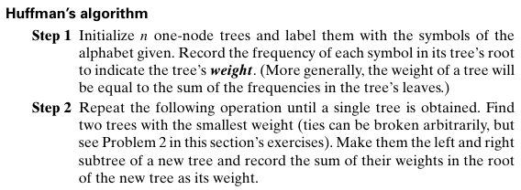
Huffman’s Algorithm

Slide 34

Huffman’s Algorithm

Slide 35
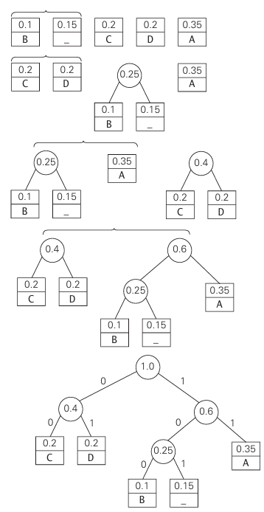
Huffman’s Tree

Slide 36

Huffman’s Algorithm
DAD is encoded as 011101
10011011011101 is decoded as BAD_AD.
With the occurrence frequencies given and the codeword lengths obtained, the average number of bits per symbol in this code is 2 . 0.35+3.0.1+2.0.2+2.0.2+3.0.15=2.25.
Had we used a fixed-length encoding for the same alphabet, we would have to use at least 3 bits per each symbol.
Thus, for this toy example, Huffman’s code achieves the compression ratio a standard measure of a compression algorithm’s effectiveness—of(3− 2.25)/3. 100%=25%.

